Slide 1
Weekly Update 7
Team Dragonflies

Slide 2
Contents
Feature engineering analysis
Features overview
Numeric features
Categories & Boolean features
conclusions
Next steps

Slide 3
Features overview
Total: 49 features
Types:
6 Categorical features (srch_id, site_id, visitor_location_country_id…)
39 Numerical features (prop_starrating, prop_review_score, prop_location_score1...)
3 Boolean features (prop_brand_bool, srch_saturday_night_bool, random_bool)
Feature “date” -->split to week or day of week

Slide 4
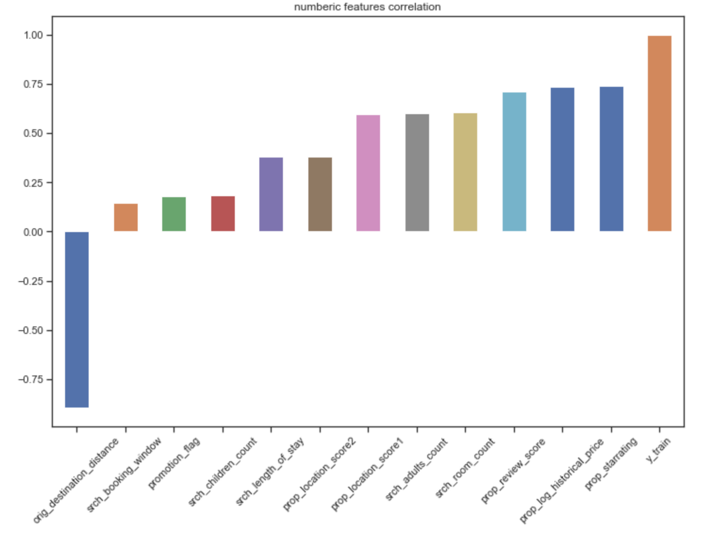
Numerical features
39 in total
27 features: more than half Nan value (remove)
12 features: calculate the correlation coefficients with target individually
High correlation coefficient features: 7 features (prop_starrating, prop_review_score, prop_location_score1, prop_log_historical_price, srch_adults_count, srch_room_count, orig_destination_distance)
Low correlation coefficient features: 5 features (prop_location_score2, promotion_flag, srch_length_of_stay, srch_booking_window, srch_children_count)

Slide 5
Categorical & Boolean features
Use Chi-square test to measure importance of categorical & Boolean features
P < 0.05: feature is important for prediction
(Categorical features): srch_id, site_id, visitor_location_country_id, prop_country_id, prop_id, srch_destination_id
(Boolean features): prop_brand_bool, srch_saturday_night_bool, random_bool, promotion_flag
Notes:
Further test independence between categorical & boolean features:
Get all possible pair of categorical & boolean features
Conduct Chi-square test on each unique pair
No one pair of categorical & boolean features are independent with each other

Slide 6
Conclusions
Features that indicate strong correlation with “price”:
Numeric Features | prop_starrating, prop_review_score, prop_location_score1, prop_log_historical_price, srch_adults_count, srch_room_count, orig_destination_distance
Categorical Features | srch_id, site_id, visitor_location_country_id, prop_country_id, prop_id, srch_destination_id prop_brand_bool, srch_saturday_night_bool, random_bool, promotion_flag

Slide 7
Next steps
Take into consideration of datetime
Build regression model

